Slide 1
Standard Deviation

Slide 2
Standard Deviation
Standard Deviation mean how our data vary from average
Standard deviation is a measure of how spread out a group of numbers is. Think of it as a way to understand how much the numbers vary from each other. It's like a ruler that tells us how much a group of numbers "bumps" around the average.

Slide 3
Why Does Standard Deviation Matter?
Let's say you have a group of numbers, like 5, 10, 15, 20, and 25. The average of these numbers is 15. But are they all close to 15, or are some much higher or lower?
Standard deviation helps answer this question. If the numbers are all close to 15, the standard deviation is small. If some are far from 15, the standard deviation is big.

Slide 4
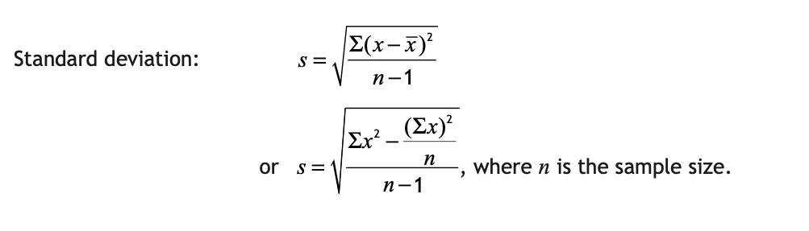

Slide 5
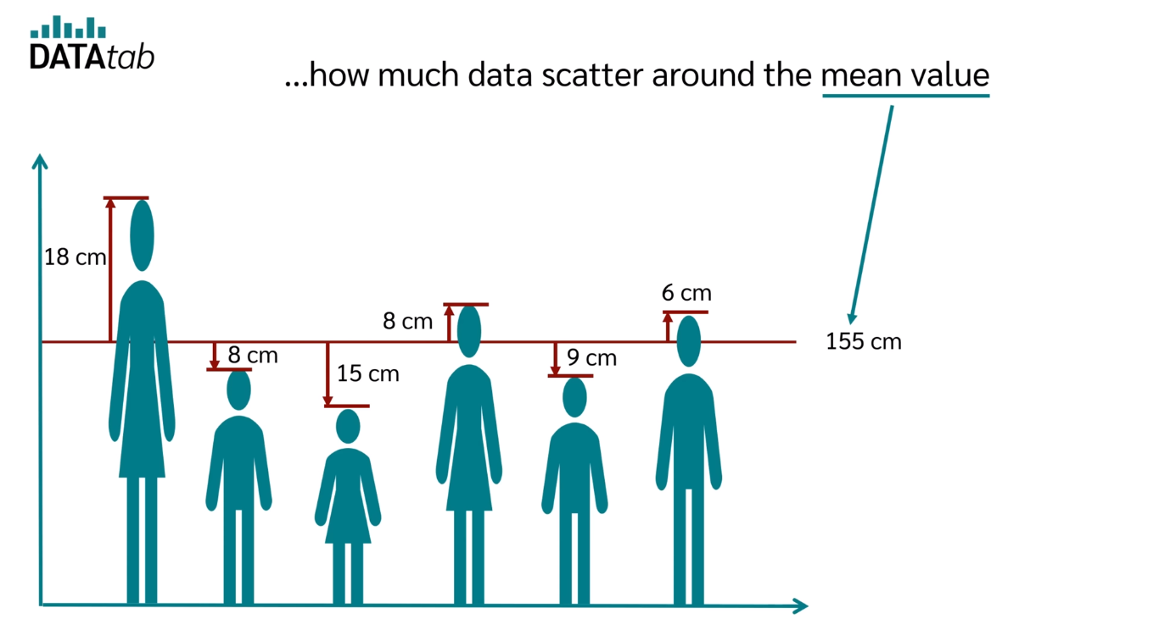

Slide 6
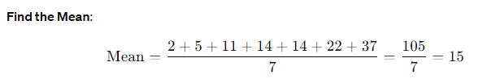
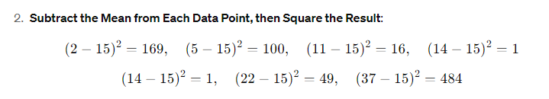
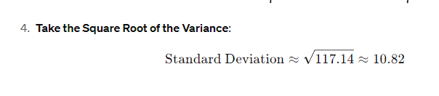
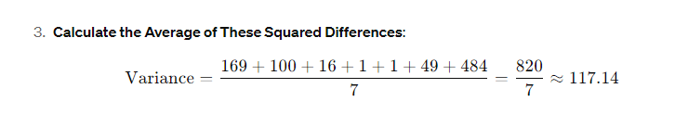
Find the standard deviation of the following data: 2, 5, 11, 14, 14, 22, 37

Slide 7
Properties
Non-Negativity: Standard deviation is always non-negative because it's the square root of a sum of squares, which are non-negative.
Sensitive to Outliers: It's heavily influenced by outliers or extreme values. This can be both helpful and misleading.
Measures Variability: Low standard deviation means numbers are close to the average, high means they're spread out.
Related to Variance: It's the square root of the variance, which is the average of squared differences from the mean.
Affected by Units of Measurement: The standard deviation depends on the units of measurement. Changing units can change it, but not the shape of the distribution.
Sample vs. Population: There are two versions: sample standard deviation and population standard deviation. Sample divides by (n-1) for sample data.

Slide 8
Thank you
That was all!

